Slide 1
Duplicate Question IDENTIFICATION system
Monodeep Das
Niranjana NK
Jyothi Rupa S

Slide 2
Agenda
Problem Statement
Proposed Approach
Results
Applications
Limitations

Slide 3
Problem Statement
Finding similar questions from large question archives.
To a user query, the model will return all the similar/duplicate questions from the dataset.

Slide 4
What is a Related Question?
Q1. How can I be a good geologist? Q2. What should I do to be a great geologist?
These two questions are related in context and semantics but different in formation.

Slide 5
What is a Non Related Question?
Q1. How can I be a good geologist? Q2. What are the expertise of a good geologist?
These two questions are not related in context although they both contain some common words.

Slide 6
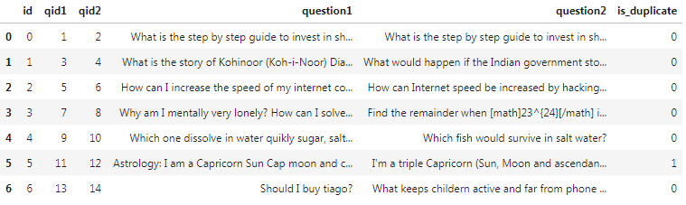
DATASET
Dataset size – 404291 pairs of questions
Is_duplicate denotes if the question pair is similar

Slide 7
Proposed Approach
Module 1
Clustering
Using NLP
NLTK
Module 2
Deep Learning
LSTM Model

Slide 8
Module 1 Architecture
Dataset
Preprocessing
Feature extraction
Clustering
Optimize Clusters
Store clusters

Slide 9
PREPROCESSING
Convert to lower case
What’s the alternative to Machine-Learning ?
what’s the alternative to machine-learning?
Removing vague characters
what’s the alternative to machine-learning?
what the alternative to machine learning
Stemming
Dataset
Preprocessing
Feature extraction
Clustering
Optimize Clusters
Store clusters

Slide 10
FEATURE EXTRACTION
Dataset
Preprocessing
Feature extraction
Clustering
Optimize Clusters
Store clusters
Noun Phrases
Nouns
Verbs
Adverbs
Adjectives
Input - what the alternative to machine learning

Slide 11

COMPLEXITY
The dataset has more than 4*${10}^{6}$ unique questions
Searching these questions every time is computationally intensive
Not a real-time solution
Hence clustering

Slide 12
CLUSTERING
Based on feature extracted, the questions are grouped together
what the alternative to machine learning
The features of the sentence are : noun – phrases : ‘machine learning’ nouns : ‘alternative’, ‘machine’, ‘learning’ verbs : ‘’ adjectives : ‘’ adverbs : ‘’
Dataset
Preprocessing
Feature extraction
Clustering
Optimize Clusters
Store clusters

Slide 13
Optimizing the clusters
Before - [‘alternative’, ‘machine’, ‘learning’, ‘machine learning’]
After - [‘alternative’, ‘machine learning’]
Unique clusters are retained
Dataset
Preprocessing
Feature extraction
Clustering
Optimize Clusters
Store clusters

Slide 14
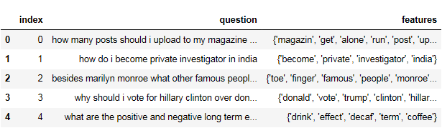
Storing clusters
Dataset
Preprocessing
Feature extraction
Clustering
Optimize Clusters
Store clusters
The clusters are saved as pickle file

Slide 15
Retrieving Similar Questions
Preprocessing
Feature Extraction
Feature Optimization
Ranking with ranking metrics
Displaying the final result

Slide 16
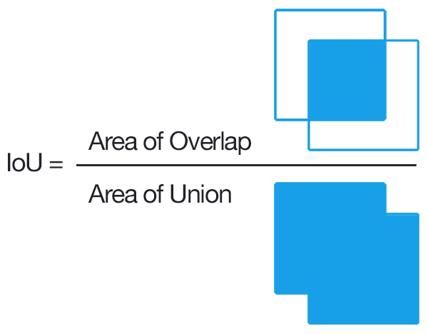
Ranking metrics
Jaccard similarity
Which are the best engineering fields ?
What is the best field of engineering ?
Jaccard score = 0.44

Slide 17
Results of module 1
Rank reduced dataset against the input question
Sort in descending order as per Jaccard score
Display the top 10 results

Slide 18
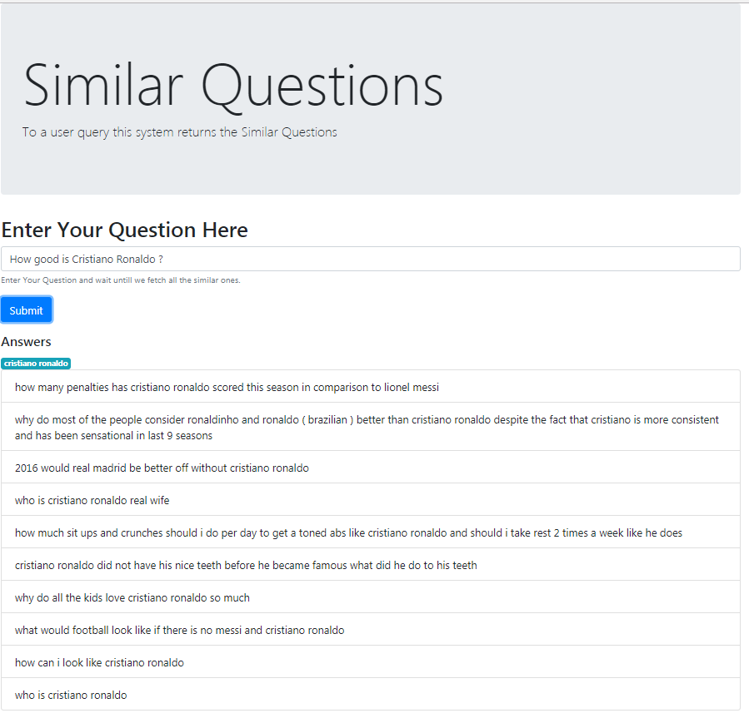
RESULT OF MODULE 1

Slide 19
Module 2 – Deep learning
What is Deep Learning?
Why LSTM?
Difference between RNN and LSTM
Eg: I lived in Bangalore for 5 years. I can speak fluent Kannada.
LSTM can predict the word based on context, RNN cannot
How does an LSTM work?

Slide 20
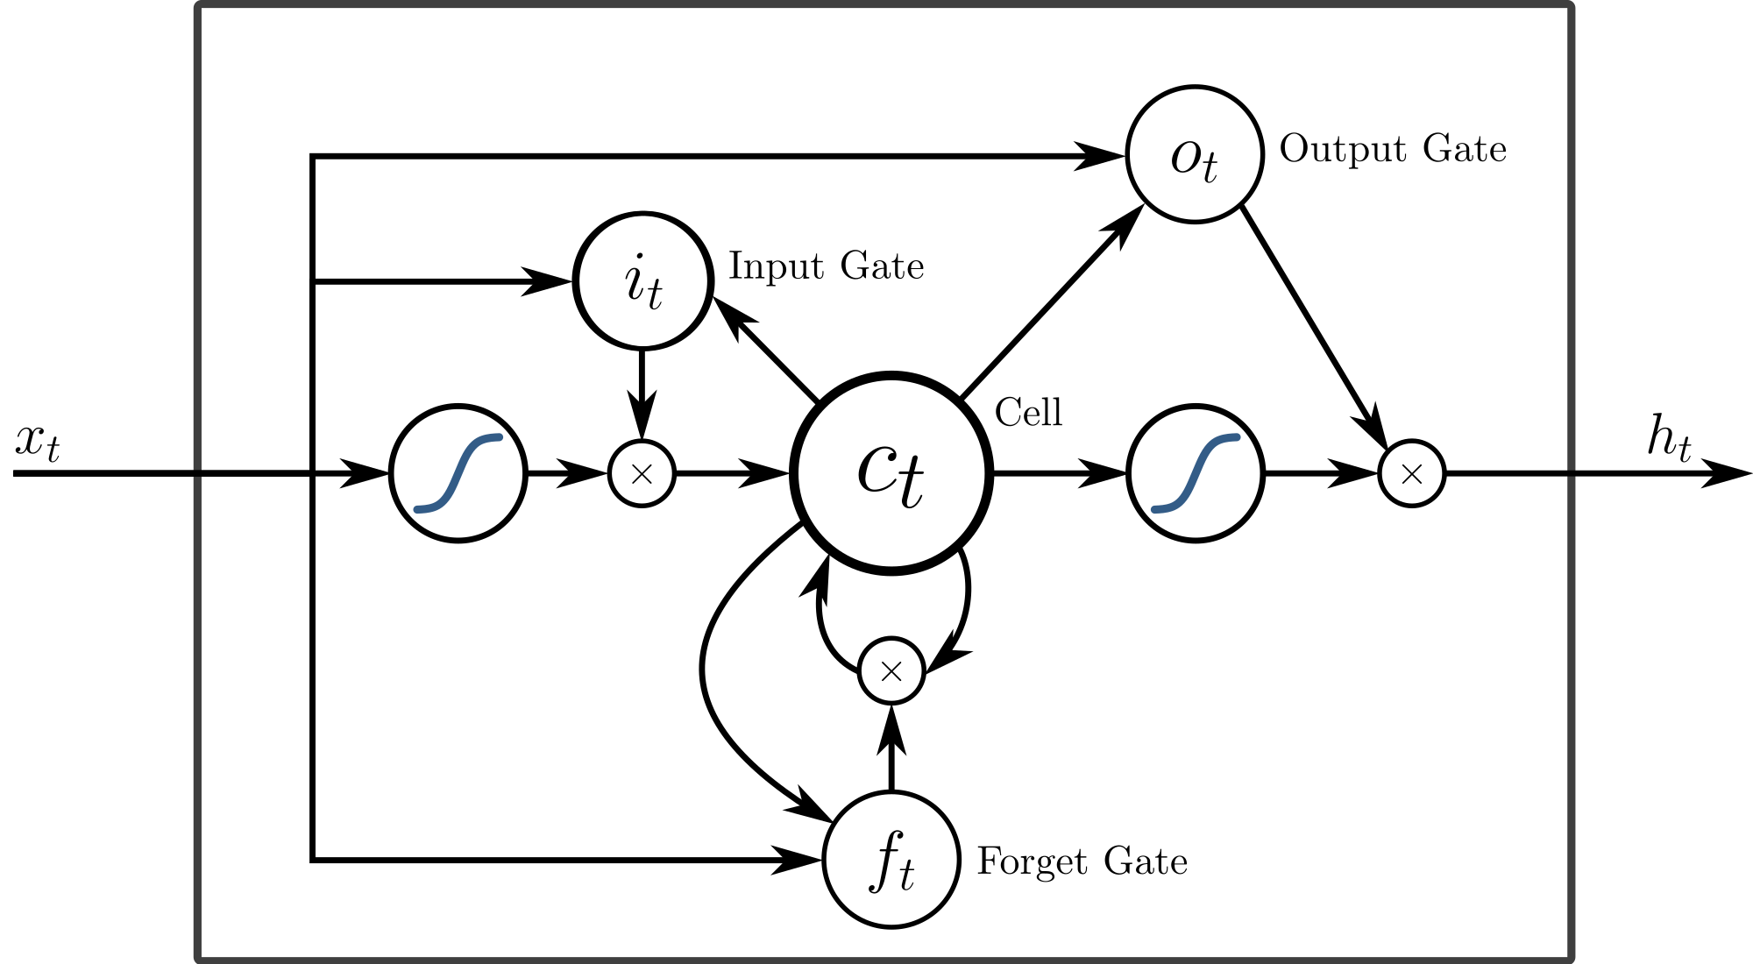
Long short term memory

Slide 21
Keras and tensorflow
Keras
Open source neural network library
Contains numerous implementations of commonly used neural network building blocks
Offers a higher-level, more intuitive set of abstractions
TensorFlow
Open source ML framework
Software library for high performance numerical computation
Flexible architecture - deployment of computation across a variety of platforms (CPUs, GPUs, TPUs)

Slide 22
Preprocessing
Tokenization
Splitting sentence into words
Generating ID for unique tokens
Padding
Example: What are some good courses on Machine Learning?
Tokenization: [2, 11, 32, 41, 625, 20, 477, 184]
Padding: [ 2, 11, 32, 41, 625, 20, 477, 184, 0, 0, 0, 0, 0, 0, 0, 0, 0, 0, 0, 0, 0, 0, 0, 0, 0]

Slide 23
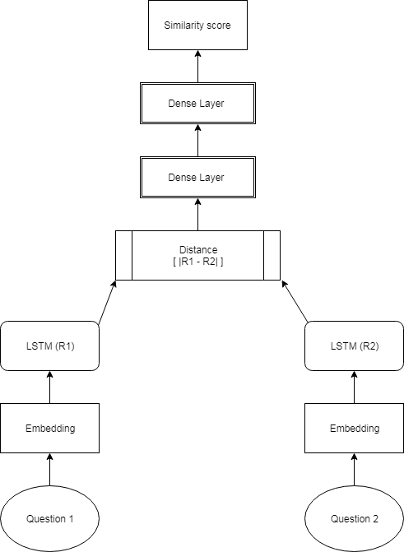
MODULE 2 ARCHITECTURE

Slide 24
EMBedding layer
Constructed using GLoVe (Global Vector Representation) file
Word Embedding Matrix is stored in a .npy file
Passed to LSTM layer with 128 nodes

Slide 25
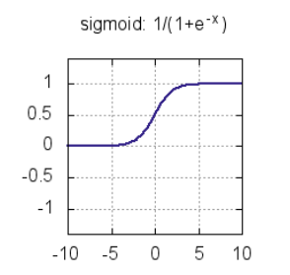
dense layer
Densely connected Neural Network layer
Performs linear operations
Series of linear operations gives linear result
Use Activation Function – Sigmoid function

Slide 26
MODULE 2 ARCHITECTURE

Slide 27
Model details
10 epochs
Early Stopping
Batch size = 256
Dropout layer
Batch Normalization
Adam optimizer
Storing trained model using .h5 file

Slide 28
Results

Slide 29
Module 1

Slide 30
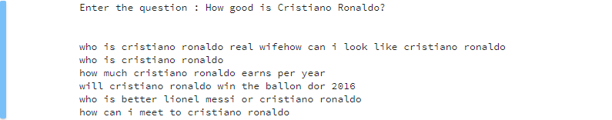
Module 2

Slide 31
applications
Chatbot for FAQ Automation
Detecting and reducing redundancy of data from any Q&A system
Faster retrieval of questions from large datasets.

Slide 32
Limitations
Efficiency depends upon the accuracy of NLTK POS tagger
Efficiency depends upon the grammatical correctness of the input question
Presence of similar questions in the used dataset

Slide 33
Any Questions?
Thank You!

